Slide 1

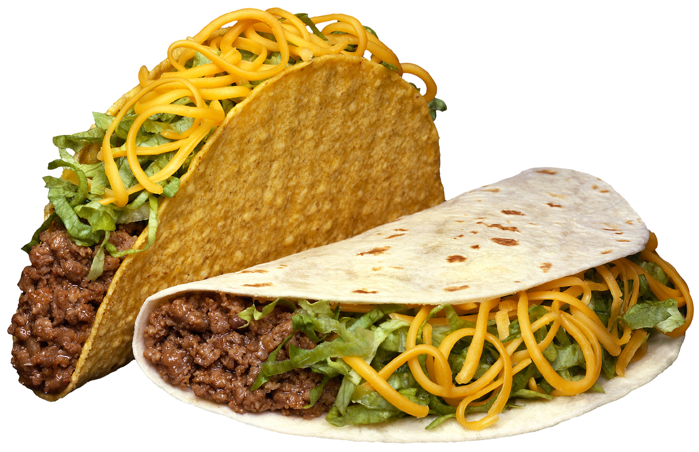
Menu
Cinco de
Hard/Soft Shells/Doritos
Beef/Chicken/Rice
Corn Relish/Refried Beans
Lettuce/Tomato/Cheese
Onions/Guacamole/Salsa
Black Olives/Sour Cream
Mayo
Fundraiser
What: Taco Bar
When: May 5, 2024 | 5-7 pm
Where: Rhodes Grove Dining Hall
Cost: Freewill Donation

